Slide 1
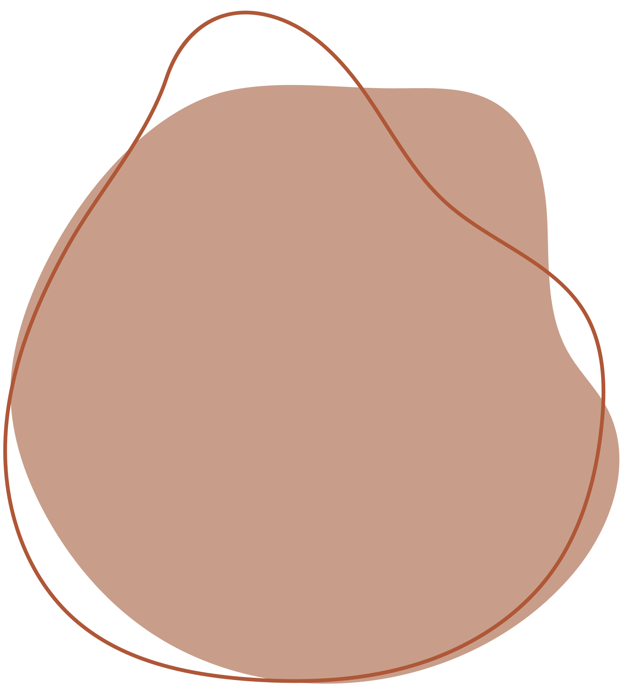

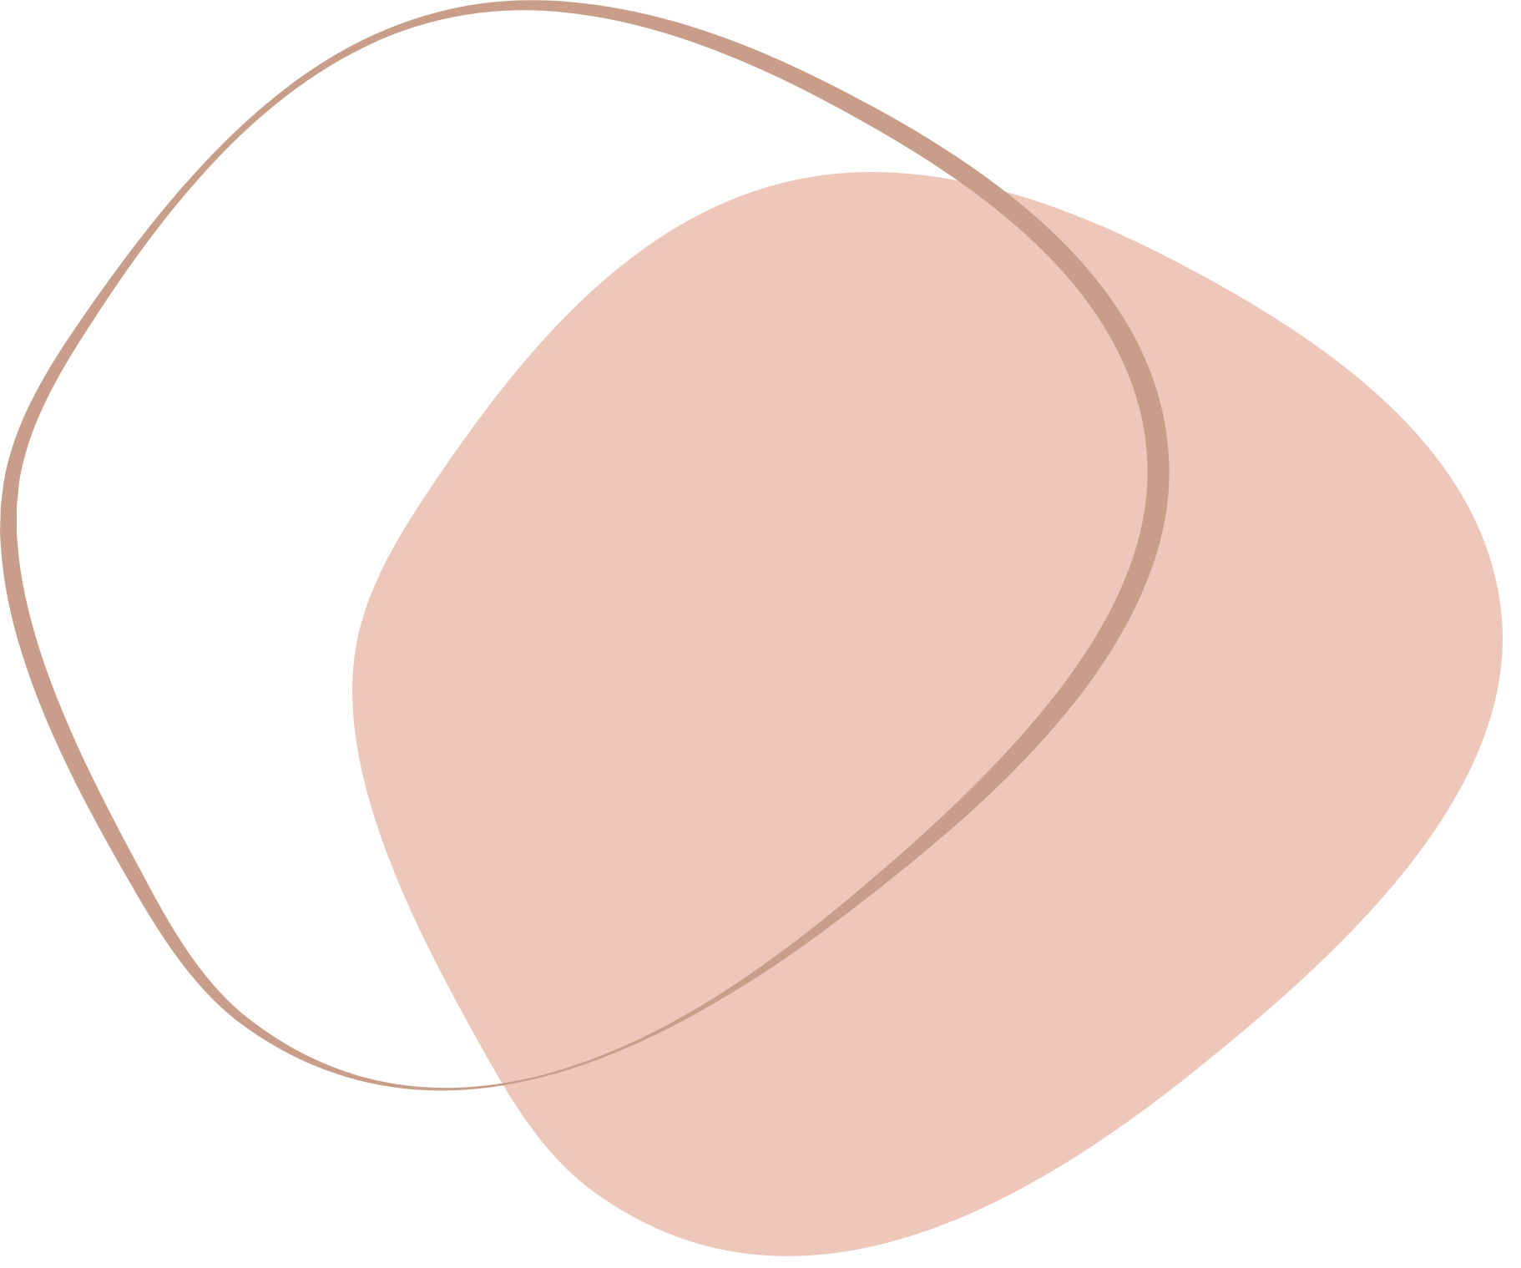

GUJARAT ARTS AND SCIENCE COLLEGE
HOMETOGO

Slide 2

WATERFALL MODEL

Slide 3





PROCESS DIAGRAM
Requirement
gathering
DESIGN
CODING
TESTING
DEPLOYMENT
MAINTANENCE

Slide 4
Phases in waterfall model :
Requiement Gathering
and analysis :
During this phase, all the relevant information is collected from the customer to develop a product as per their expectation.Business analyst and Project Manager set up a meeting with the customer to gather all the information like what the customer wants to build, who will be the end-user, what is the purpose of the product. Before building a product a core understanding or knowledge of the product is very important.
2. Design :
In the design phase, one or more designs are created to achieve the project result. Depending on the project subject, the design phase products include dioramas, flow-charts,etc.
3. Implementation :
Implementation/Coding starts once the developer gets the Design document. The Software design is translated into source code. All the components of the software are implemented in this phase.

Slide 5
4. Testing :
Testing starts once the coding is complete and the modules are released for testing. In this phase, the developed software is tested thoroughly and any defects found are assigned to developers to get them fixed.
Retesting, regression testing is done until the point at which the software is as per the customer’s expectation.
5. Deployment :
Once the product is tested, it is deployed in the production environment or first UAT (User Acceptance testing) is done depending on the customer expectation. If the customer finds the application as expected, then sign off is provided by the customer to go live.
6. Maintenance :
After the deployment of a product on the production environment, maintenance of the product. i.e. if any issue comes up and needs to be fixed or any enhancement is to be done is taken care by the developers.

Slide 6
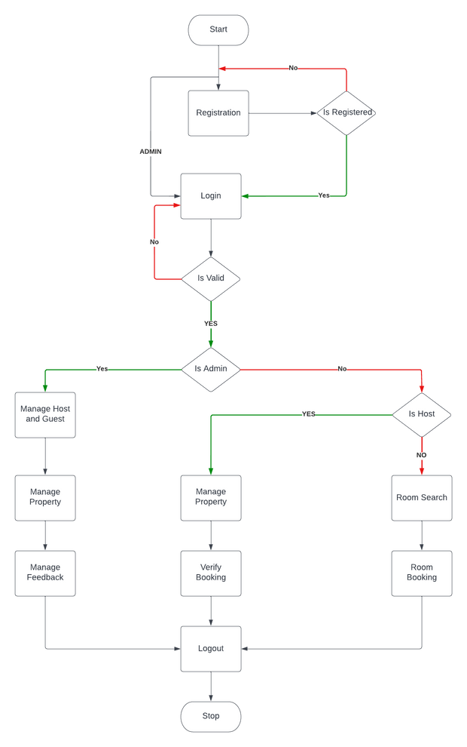
SYSTEM FLOW DIAGRAM

Slide 7
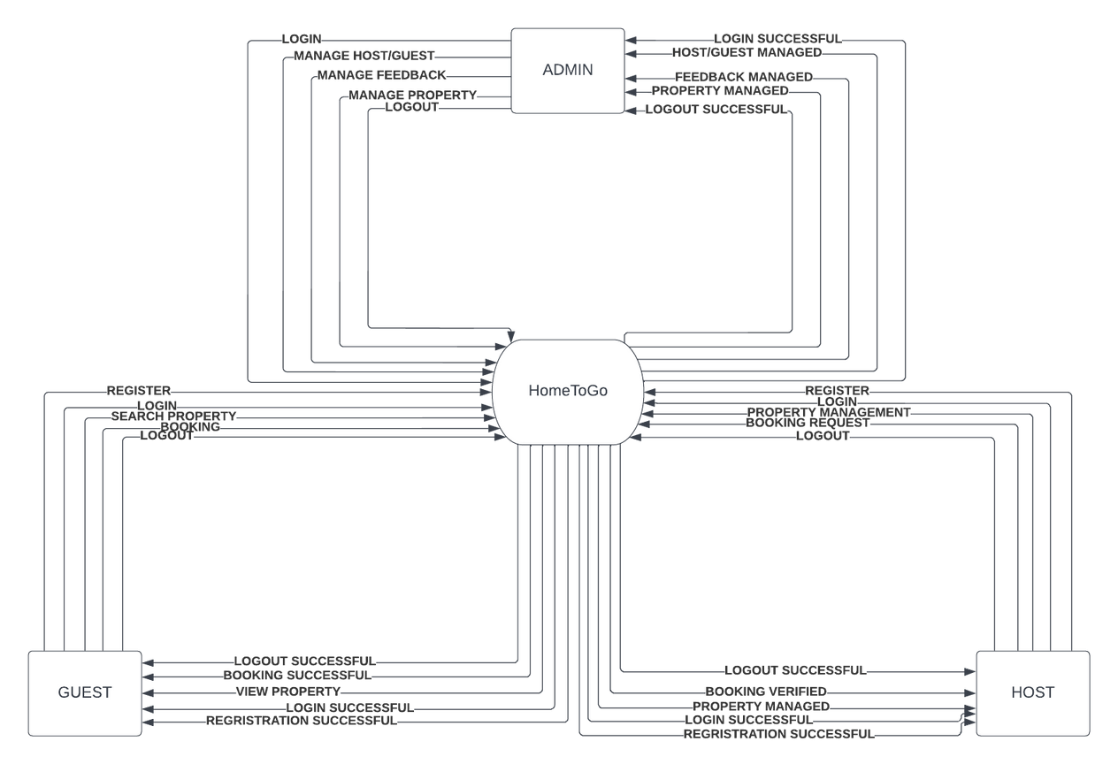
DATA FLOW DIAGRAM

Slide 8


